Slide 1



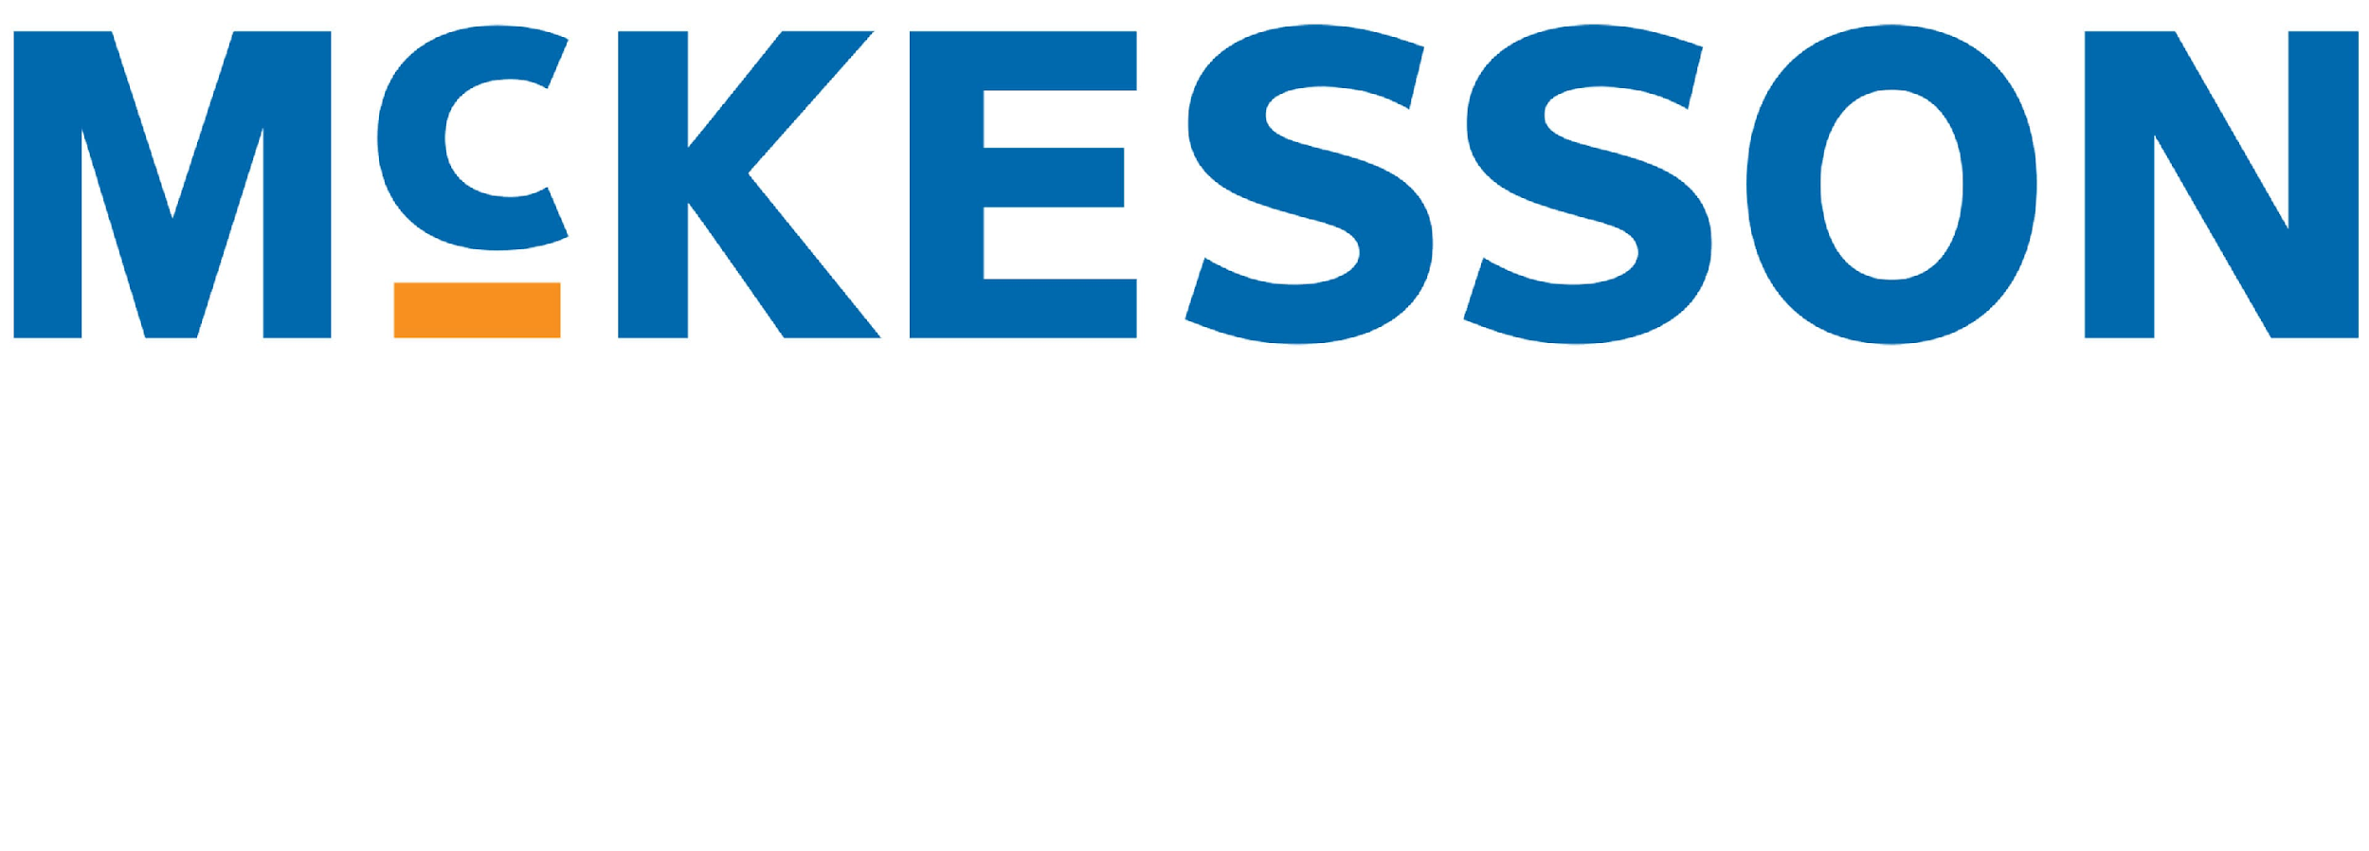























© 2024 NATIONAL INDEPENDENT CONSULTANTS
OF ELECTRONIC HEALTHCARE RECORDS
DUNS:078606581 CAGE: 7CTE3
C A P A B I L I T Y S T A T E M E N T
The NICEHR Group (TNG) is the ONLY healthcare IT consultant firm in the industry that is consultant owned and operated.
We provide the healthcare industry with elite consultants who simplify the EHR implementation along with integrating new technologies to improve the efficiency and quality of patient care.
We have a network of over 1,000 consultants with experience in all aspects of EHR implementation from pre to post.
SET-ASIDE PROGRAMS
SBA 8(a) Program Certified
Minority-Owned Business
Small Business
Small Disadvantaged Business
CERTIFICATIONS
CMMI Level 3 Appraisal
ISO 9001:2015 QMS
ISO 8000-110:2009 Data Quality
INDUSTRY CONNECTIONS
Microsoft Certified Partner
Apple Developer
Oracle Partner
Microsoft .NET
Microsoft SQL Server
Microsoft Azure Government
Amazon AWS GovCloud
NAICS SIC CODES
541611 Administrative Management and General Management Consulting Services
8742 Management Consulting Services
CORE COMPETENCIES Expertise in EHR implementation from pre to post including EPIC, Oracle Cerner, Veradigm formerly Allscripts, EClinicalWorks, McKesson, NextGen Healthcare, GE Healthcare, Meditech, Athenahealth. Expertise in Data Migration & Security.
Mission Support Services · Information Management · Revenue Cycle Management · Program, Planning & Management Services · Cybersecurity Services & Support · Training Services · Enterprise Customer Service
DIFFERENTIATORS Consultant Owned & Operated, Network of 1,000 consultants,
TNG HIPAA compliant app, DiSCheduler, VA & Unemployment Workforce Development National Training Program, Kliks-Patented EHR specialized Remote help desk support
COMMITTED EXPERTS TNG consultants are invited into a network of experts that have extensive EMR and EHR experience and are able to provide top notch oversight and commitment to ensure every project’s success. We enable a streamlined and hassle-free process for healthcare organizations looking to implement electronic health records. Our mission is to help healthcare providers improve patient care and efficiency by simplifying the EHR implementation process.
INDUSTRY VETTED With TNG’s consultant ownership model, clients receive direct access to the most talented and accomplished professionals in the industry, ensuring maximum value at minimal cost. All TNG consultants undergo rigorous vetting before joining our ranks, guaranteeing exceptional skill levels across all service areas.
CLIENT TESTIMONIAL
“I was lucky to work with Rafael in our busy Emergency Department. He trained me during the go-live phase of physician order entry.
Rafael’s knowledge and excellent communication skills were the key to making the whole process efficient and stress free.
Our hospital decided to retain a small team of go-live staff for some additional training. Our group of physicians unanimously voted for Rafael.”
Lee Millward, MD -
Methodist Fremont Health Medical Center
CLIENTS
TheNICEHRGroup.com · 212-203-3513 · info@thenicehrgroup.com
Notes:
1. Introduction about your business.
2. Core Competencies (List of products and services you are offering and images if you have)
3. NAICS, FCS & PSC Codes
4. Past Performance
5. Expected Future Performance
6. Differentiators
7. Certifications
8. Company's detail ( Company name, e mail address, contact details, location, owner name etc)
Microsoft Certified Partner
Apple Developer
Oracle Partner
Microsoft .NET
Microsoft SQL Server
Microsoft Azure Government
Amazon AWS GovCloud

